Slide 1



"Optimizing Query Translation: Understanding Machine Learning Model Sensitivity and Uncertainty in NLP"
Name: Venkatesh Sattenapalli
StudentID: 23030670
Module Code: 7PAM2002-0206-2024
Course: Msc Data Science with Sandwich
Supervisor: Pushp Tiwari

Slide 2



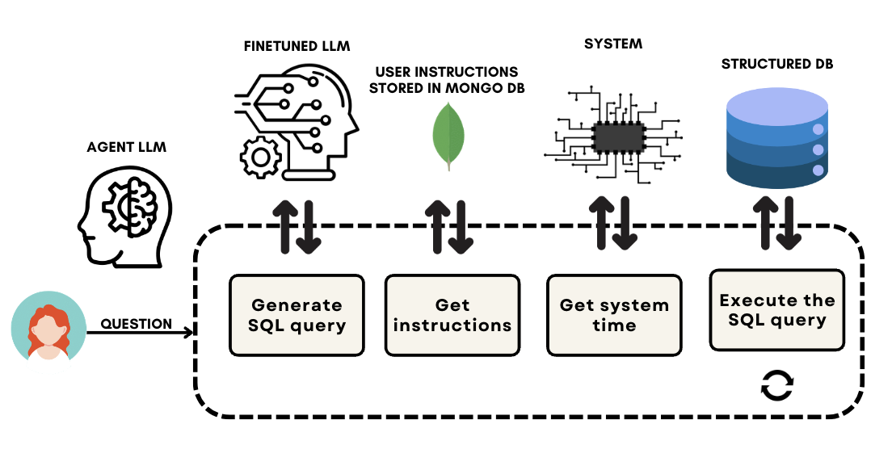
Introduction
Understanding and automating SQL query translation using LLMs improves data accessibility and efficiency.

Slide 3

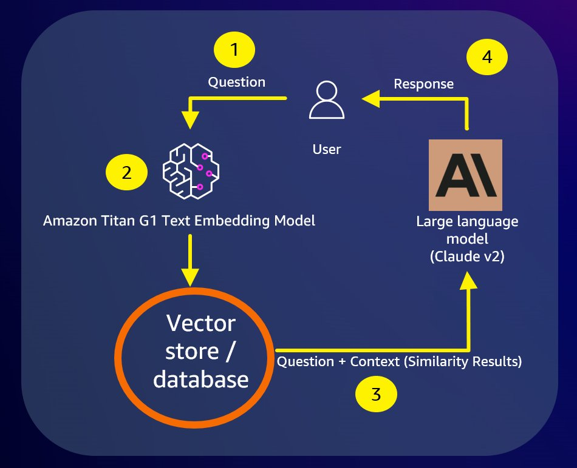





OVERVIEW
Methodology
Use case for a GenAI using Amazon RDB for SQL server as a vector store
01
End user question
02
G1 text Embedding Model
03
Chroma DB
07
04
Question + context (Similarity result)

Slide 4


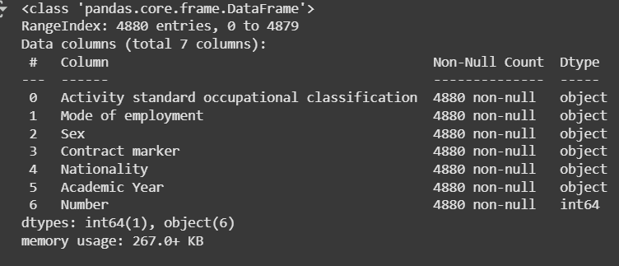


Dataset Overview
Dataset Source: Higher Education Statistics Agency (HESA)
URL: https://www.hesa.ac.uk/data-and-analysis/sb261/figure-1.csv
Key Features:
Activity standard occupational classification (Categorical)
Mode of employment (Categorical)
Sex (Categorical)
Contract marker (Categorical)
Nationality (Categorical)
Academic Year (Categorical)
Number (Numerical)

Slide 5


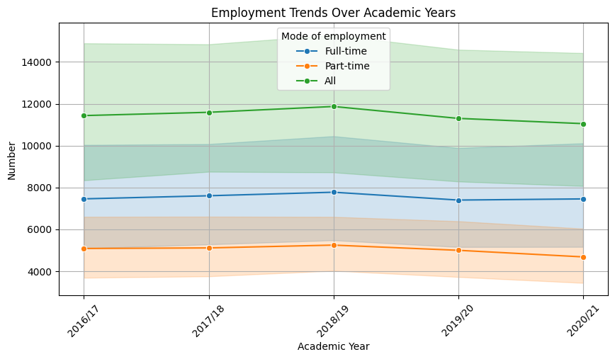

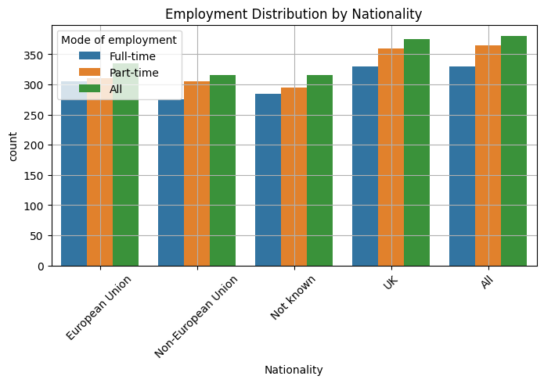
Preliminary Results
Lack of Design Skills
Many users lack the expertise to design visually appealing presentations, which can detract from the overall message and impact of their content.
Collaboration Issues
Teams frequently struggle to collaborate effectively on presentation content, leading to inconsistencies and inefficiencies that can undermine team efforts.

Slide 6
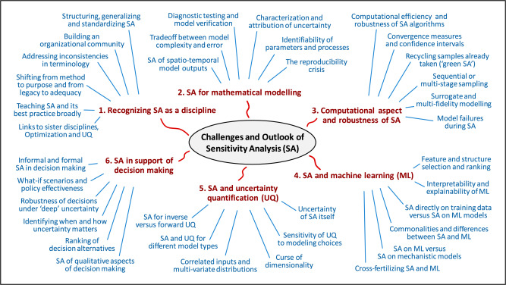
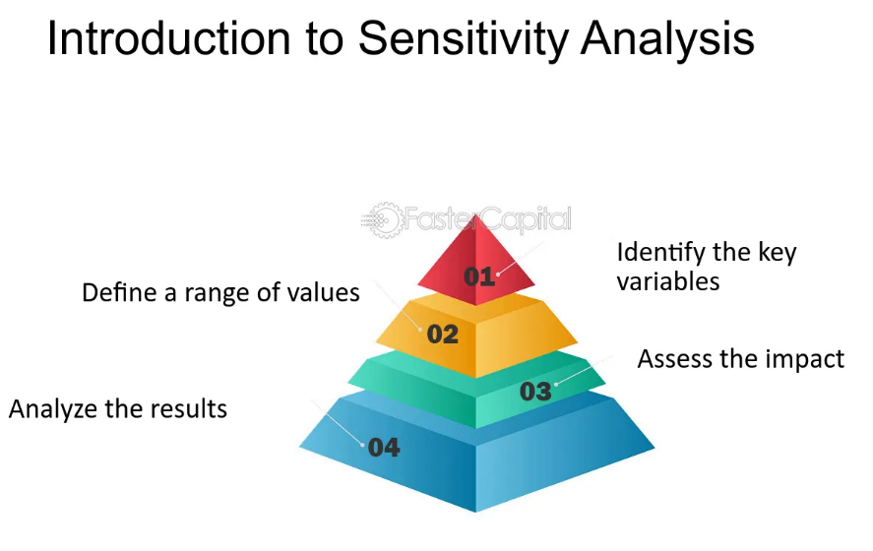


Future work
Sensitivity analysis is a powerful technique that helps quantify how parametric variations influence a model's output, offering insights into model robustness and performance (Maldonado & Anitescu, 2020).
global sensitivity analysis techniques, such as variance-based methods, provide deeper insights by studying the effect of the entire parameter space rather than isolated variations.

Slide 7









Gantt-Chart
Viva preparation
Dates -
Dates – May-2-May-13
I
Final Report Writing
Dates –April-13-April-29 (16 days)
Preliminary Results Analysis
Dates – April-6-April-13 (7 days)
Experimentation & Implementation
Dates –March-12 – April-5 (25 days)
Methodology Development
Dates – Feb 26 – March 11 (14 days)
Literature Review
Dates –Feb 13 to 25 (13 days)

Slide 8


References
https://arxiv.org/html/2406.08660v1
https://colab.ws/articles/10.1109%2Ftii.2019.2952929
https://ieeexplore.ieee.org/abstract/document/10553509
Yujian Gan, Xinyun Chen, Jinxia Xie, Matthew Purver, John R. Woodward, John Drake, and Qiaofu Zhang. 2021. Natural SQL: Making SQL Easier to Infer from Natural Language Specifications. In Findings of the Association for Computational Linguistics: EMNLP 2021, pages 2030–2042, Punta Cana, Dominican Republic. Association for Computational Linguistics.
Deep Learning Driven Natural Languages Text to SQL Query Conversion: A Survey - Scientific Figure on ResearchGate. Available from: https://www.researchgate.net/figure/Model-Based-Interactive-Semantic-Parsing-57_fig2_362591751 [accessed 1 Feb 2025]
https://vldb.org/pvldb/vol13/p57-jung.pdf
https://www.vldb.org/pvldb/vol13/p1737-kim.pdf
Adam Wiemerslage, Kyle Gorman, and Katharina von der Wense. 2024. Quantifying the Hyperparameter Sensitivity of Neural Networks for Character-level Sequence-to-Sequence Tasks. In Proceedings of the 18th Conference of the European Chapter of the Association for Computational Linguistics (Volume 1: Long Papers), pages 674–689, St. Julian’s, Malta. Association for Computational Linguistics.
https://arxiv.org/pdf/2202.02664
Dasari Sreeramulu, Madhusudhan. (2023). Sensitive Analysis of Natural Language Processing Using for MOORA Method. Computer Science Engineering and Technology. 1. 46-53. 10.46632/cset/1/1/6.
https://pmc.ncbi.nlm.nih.gov/articles/PMC8445976/
https://openreview.net/pdf?id=ofiZbAmrZh
https://arxiv.org/pdf/2406.05213

Slide 9





Thank you

